Slide 1
Multivariate Analysis

Slide 2
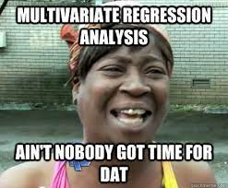


Multivariate Analysis
MSc. Kian Jenab
PhD student
Devision of Terrestrial Ecosystem Research
Centre for Microbiology and Environmental Systems Science
University of Vienna
Email: kian.jenab@univie.ac.at

Slide 3
Introduction
Multivariate analysis commonly defined as comparison of more than two variables
They are also called “Ordination Methods” in biology and ecology.
Outside biology and Ecology, they are called “ Scaling Methods”
Aim of these methods is to reduce the multidimensionality given by the many variables (= dimensions)

Slide 4
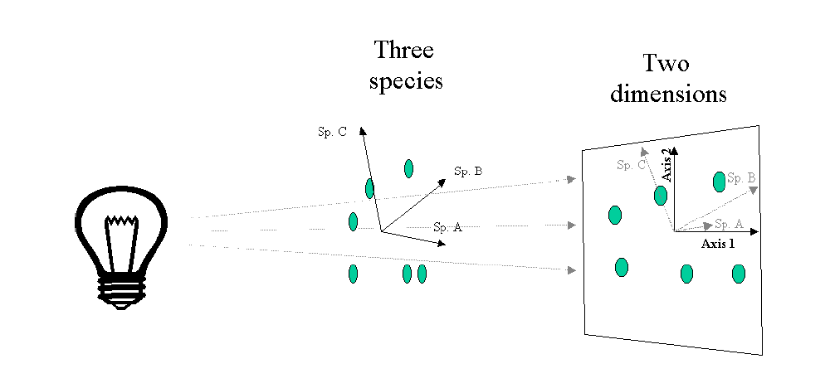
Multivariate data is complex
Multivariate Methods aim at reducing complexity
Find underlying structures - latent variables
Latent variables should be uncorrelated (collinearity)

Slide 5
Type of data
Often count data
Presence-Absence, binary data (0-1 or TRUE – FALSE)
Discrete Measurements (integers)
Biomass data (Relative abundance, counts/area or volume)
Gene expression
Biochemical parameters
Fatty acids, pigments, contaminants, enzymes, proteins, carbohydrates and….
Note that multivariate metods are not restricted to the analysis of biological communities

Slide 6
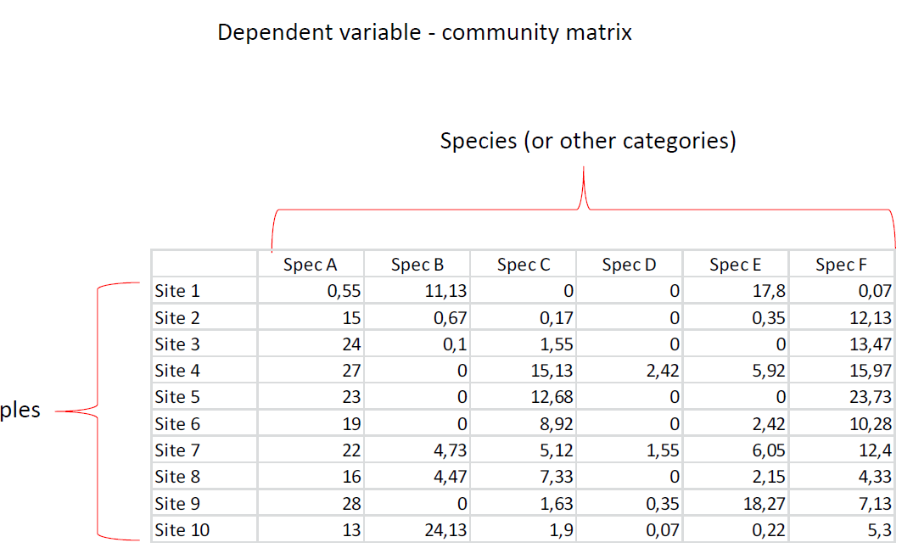
Multivariate data - structure

Slide 7
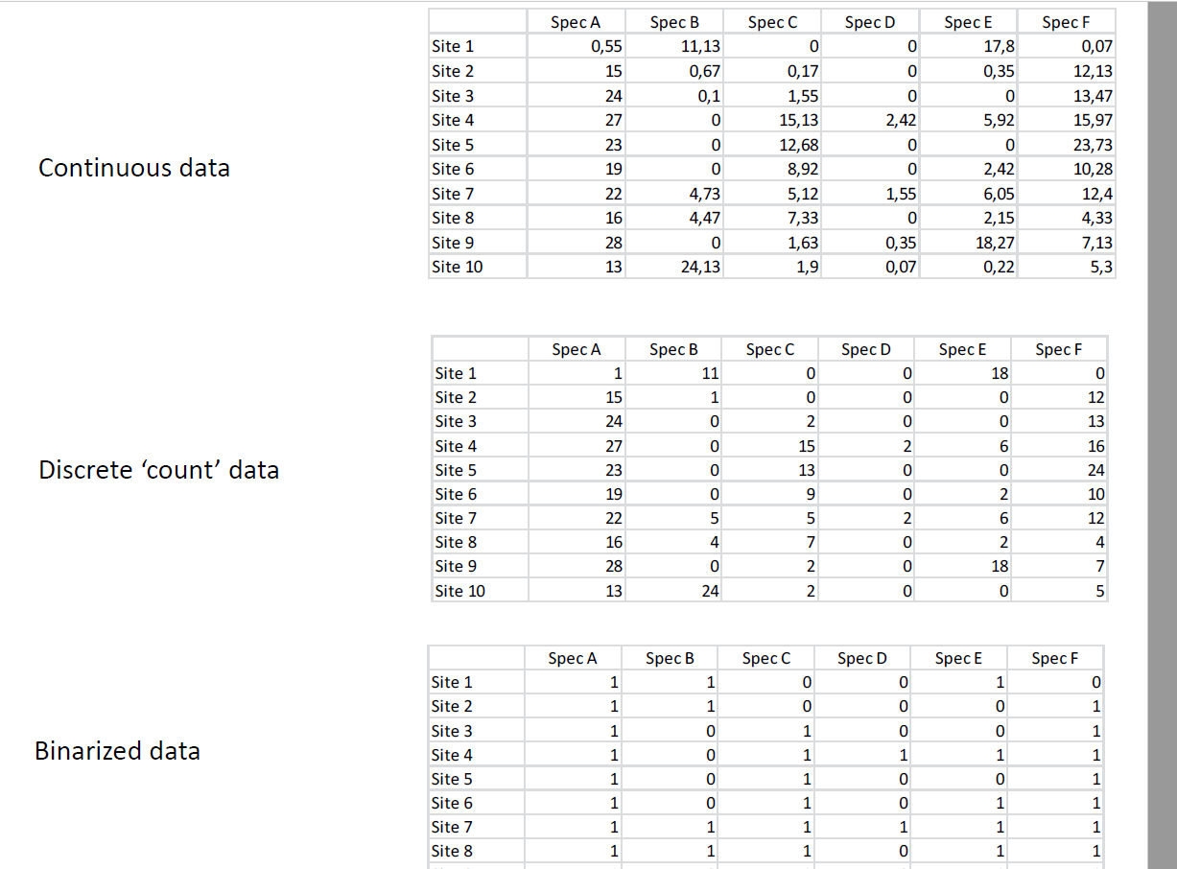

Slide 8
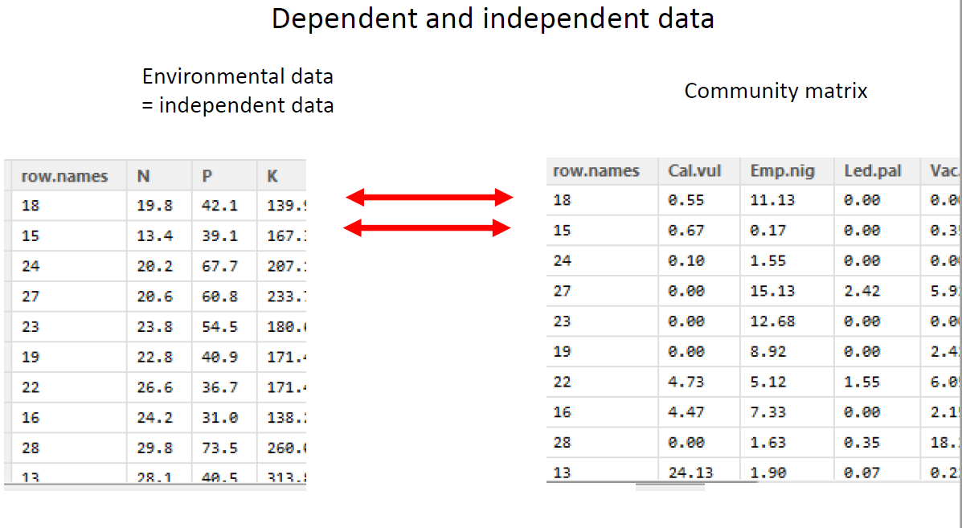

Slide 9
Ordination Methods
Unconstrained (indirect) methods
Example: PCA, CA, DCA, NMDS
Require only a community matrix
Underlying structures/latent variables are solely based on the structure of the data
Constrained (direct) methods
Example: RDA, CCA, DCCA
Require community data + independent predictors (Environmental data)
Latent axes constructed from independent data

Slide 10
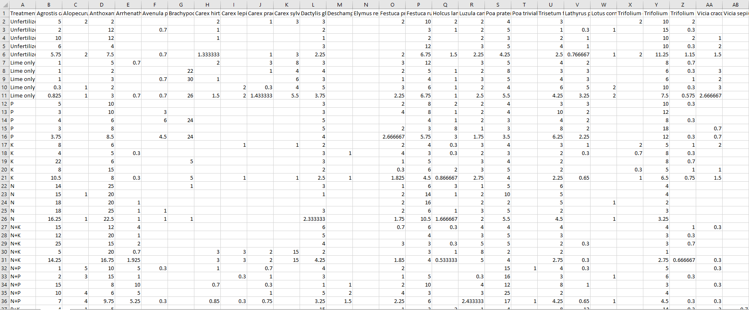
CA (Correspondence Analysis)

Slide 11
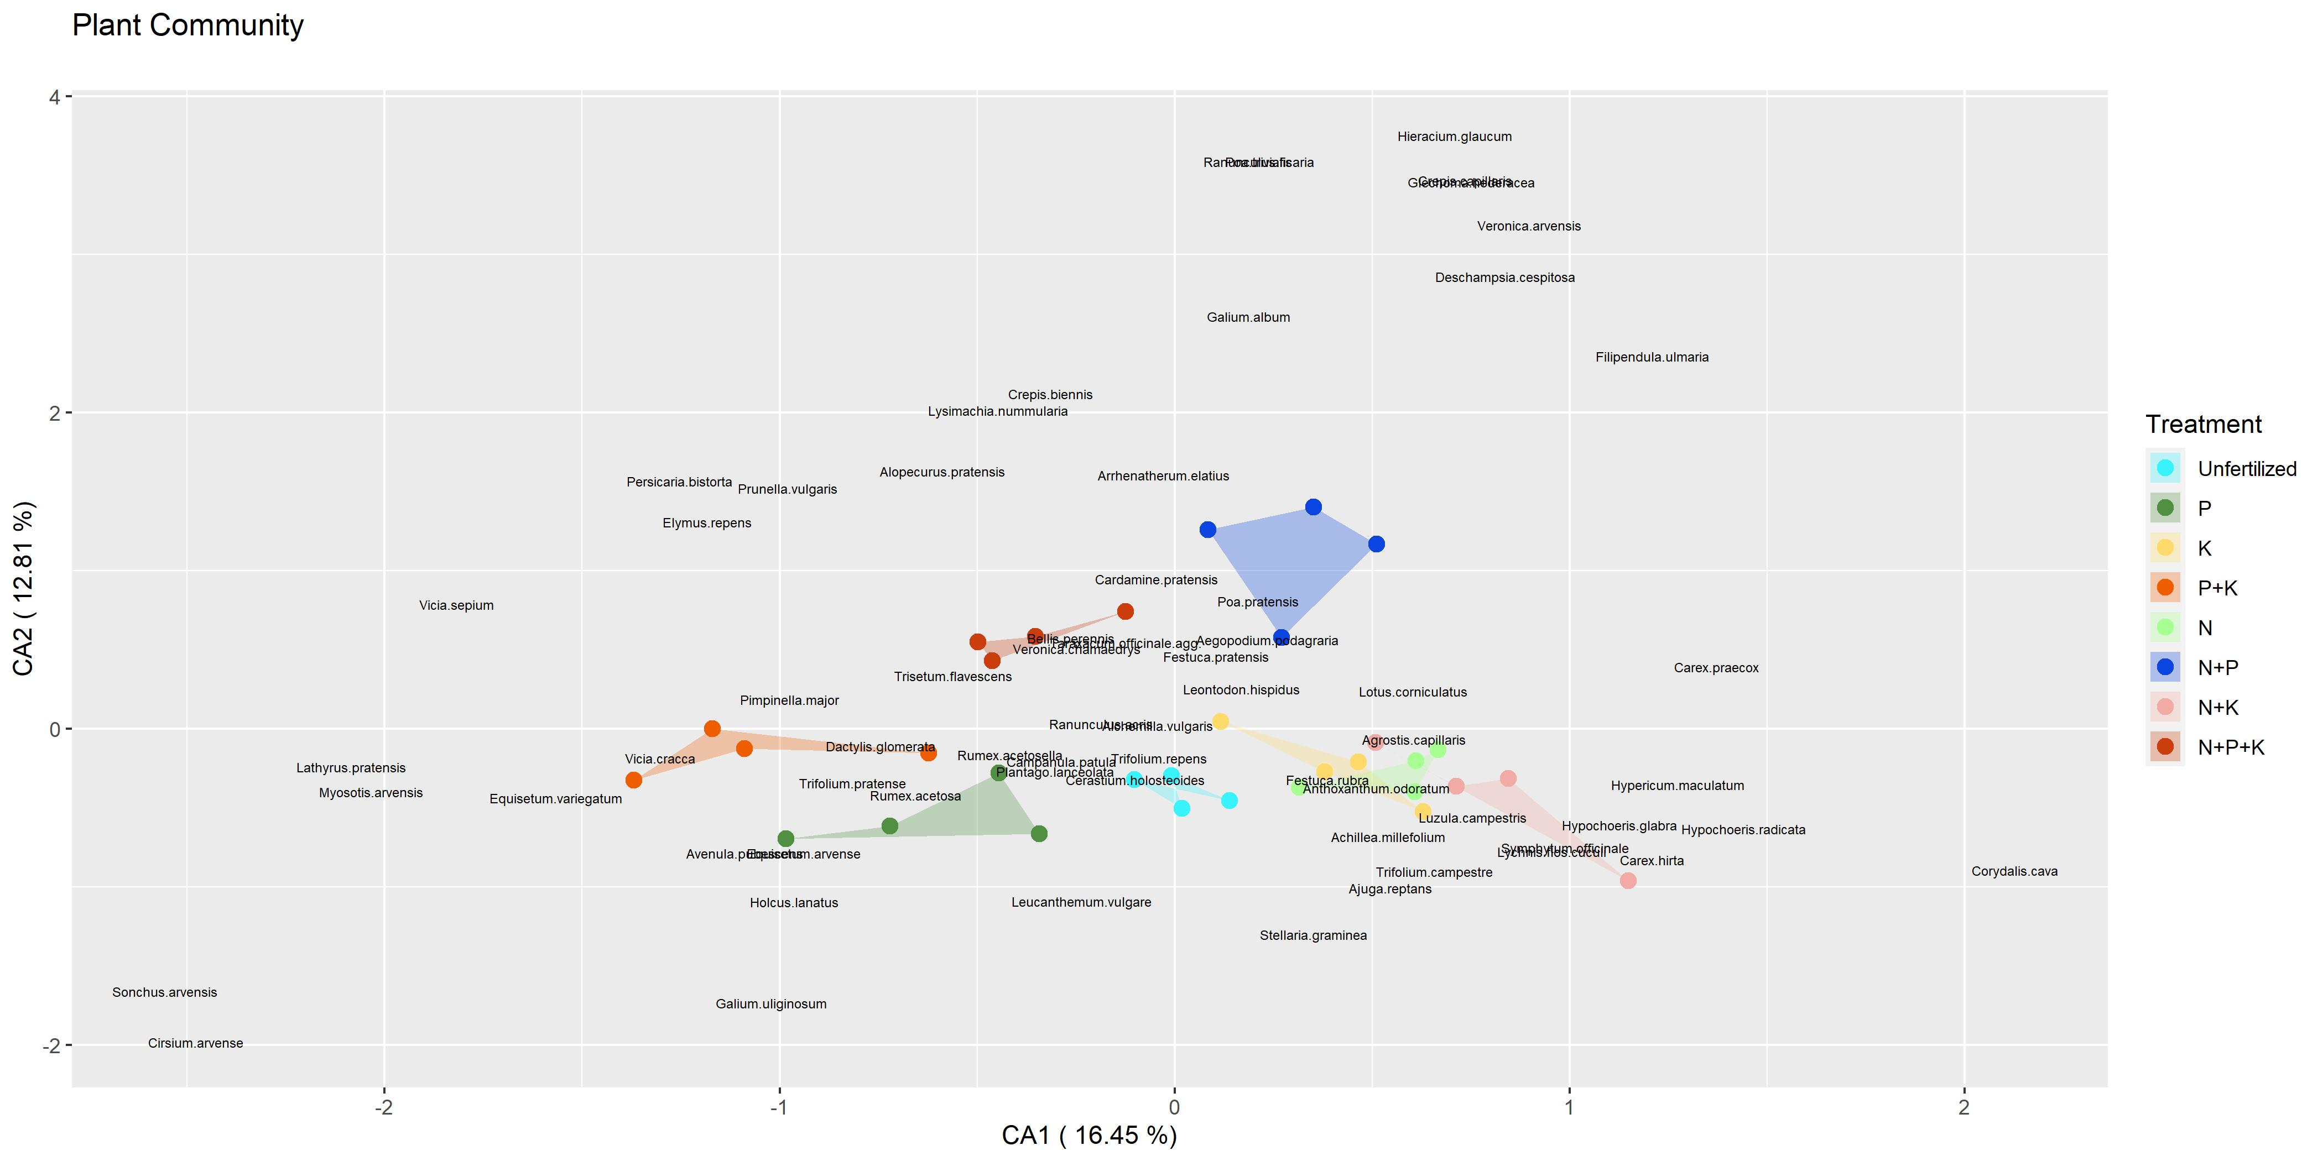
CA inBiplot

Slide 12
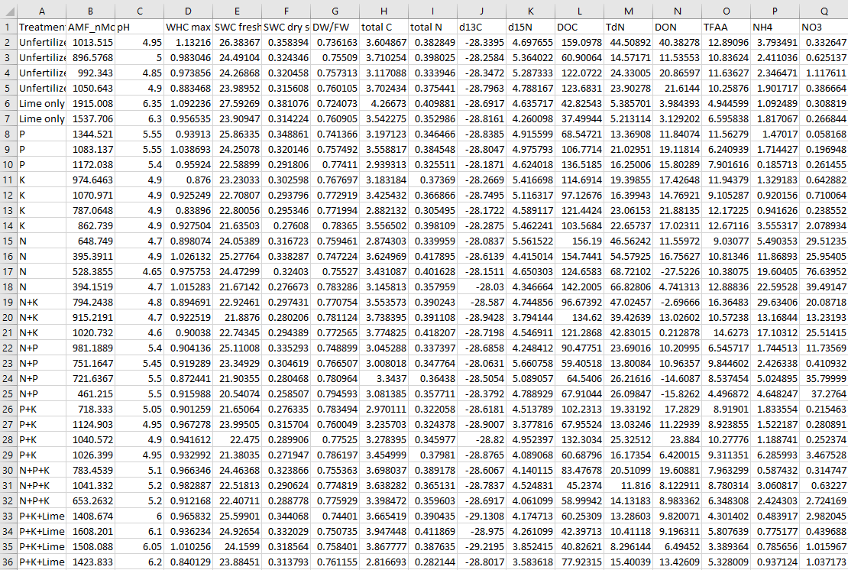
CCA (Canonical Correspondence Analysis)
Environmental Variables
Community Matrix

Slide 13
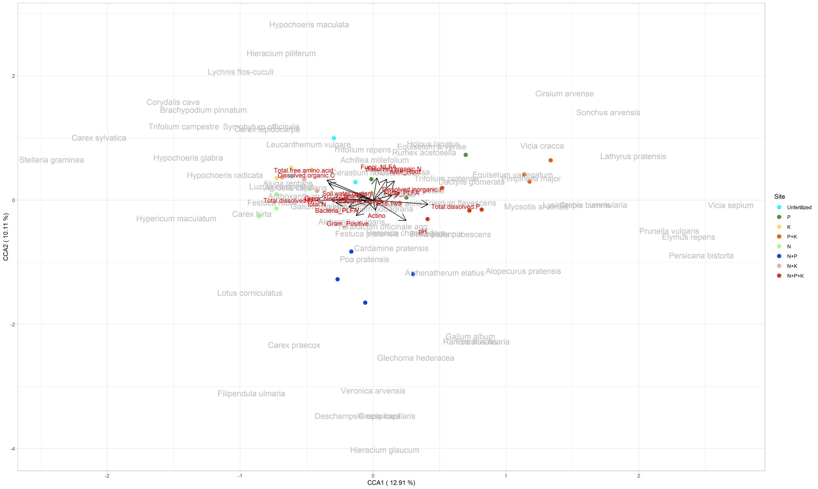
CCA in Triplot

Slide 14
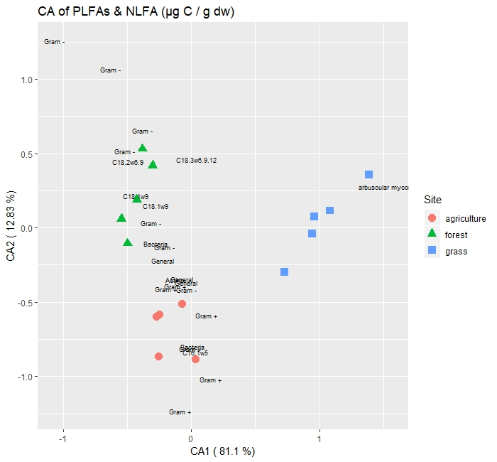

Slide 15
